Slide 1

Weltgebetstag 2022
Verfasst von den Frauen des WGT England, Wales und Nordirland
«Ich will euch Zukunft und Hoffnung geben» Jeremiah 29,1-14
wgt.ch

Slide 2

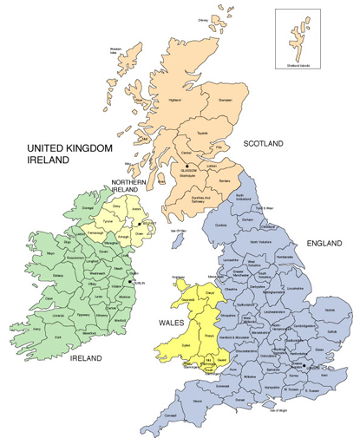

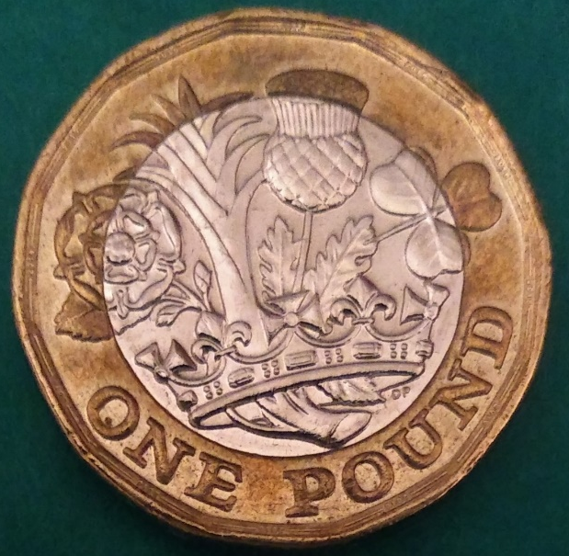

Orte und Räume
Flags © 2020 country flags – part of ProFlags BV
Der Union Jack ist die offizielle Flagge des Vereinigten Königreichs und Nordirlands.
Walisische Flagge
© 2020 Nick Hallas
England - Rose
Wales - Lauch
Schottland - Distel
Irland - Klee
© Bruce Jones Design 2009
Englische Flagge
Notes:
England, Wales and Northern Ireland are three parts of the United Kingdom (UK), within the group of islands known as the British Isles. Scotland is also part of the United Kingdom. Although there is much that we share, we are also diverse, with different languages, cultures and governments.

Slide 3
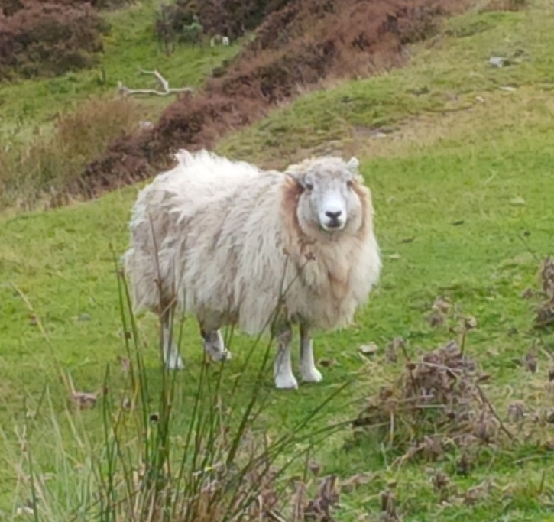
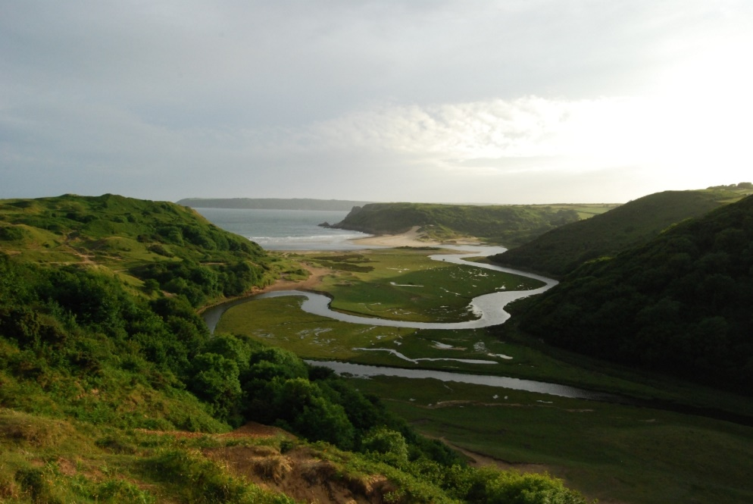
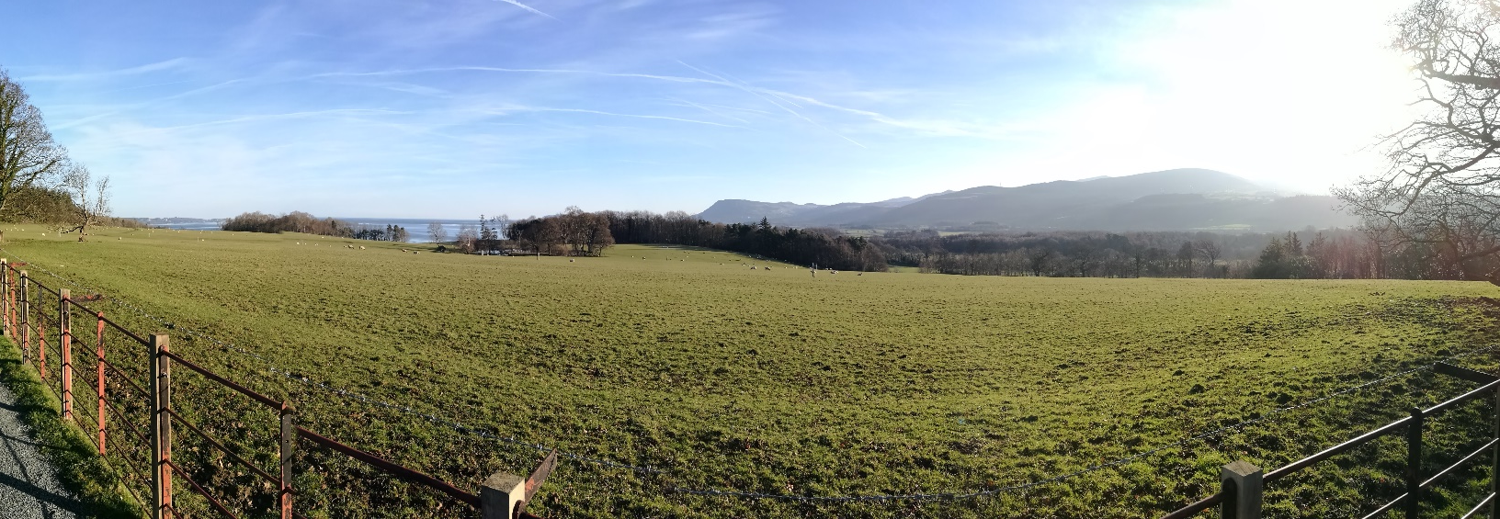
Wales
© Christine Miles
© Abielle Hallas
In Wales leben knapp über 3 Millionen Menschen und über 10 Millionen Schafe
Kilvrough
Blick vom Penrhyn Castle, Bangor, über die Berge und das Meer
© Rhianydd Hallas
Notes:
Wales is rural in character, straddled by mountains and bounded by a rugged coastline. Its large coalfields to the South provided a key export from cities such as Newport, Swansea and Cardiff.

Slide 4
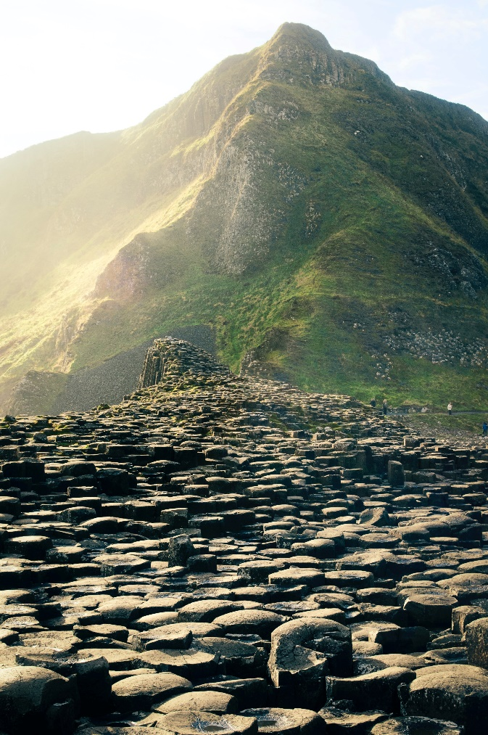
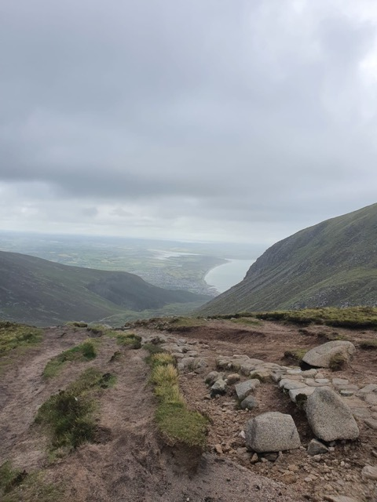
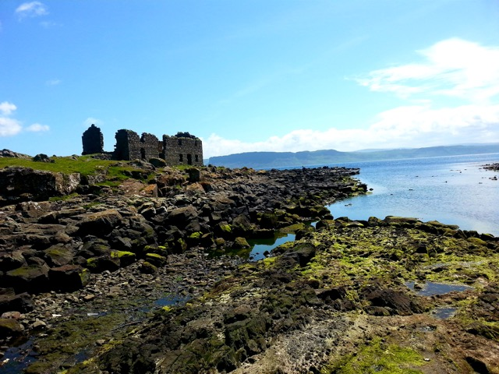
Nordirland
Die Mournes
© Louise Bowes
© Louise Bowes
© Patrick Metzdorf
Giant’s Causeway
Damm des Riesen
Die Insel Rathlin
Notes:
Northern Ireland boasts Lough Neagh, one of the largest freshwater lakes in Western Europe, as well as the spectacular Giant's Causeway, a mass of interlocking basalt columns off the Antrim coast, caused by an ancient volcanic eruption.

Slide 5
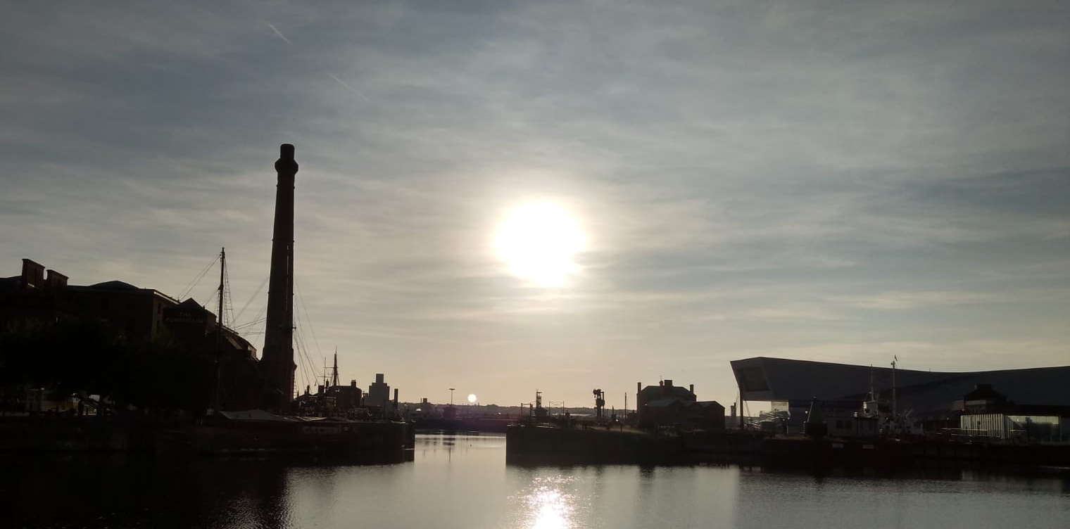
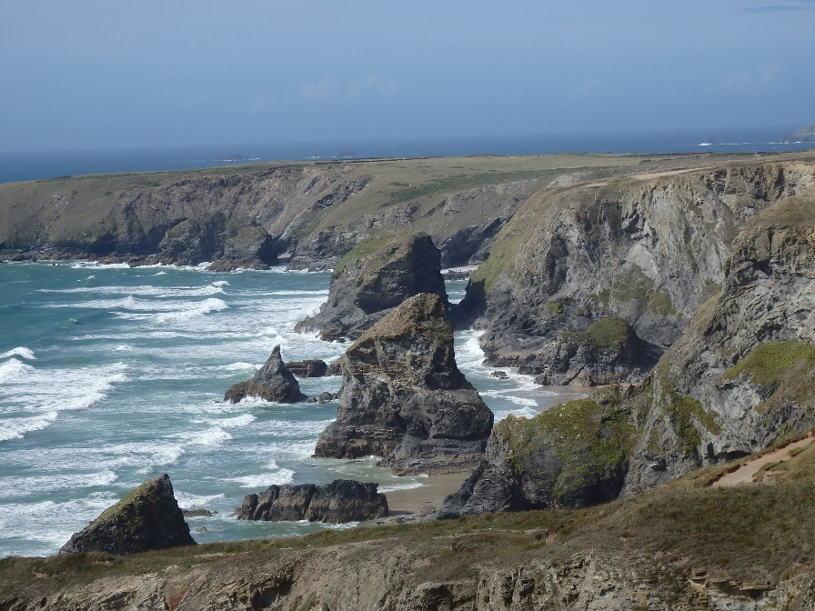
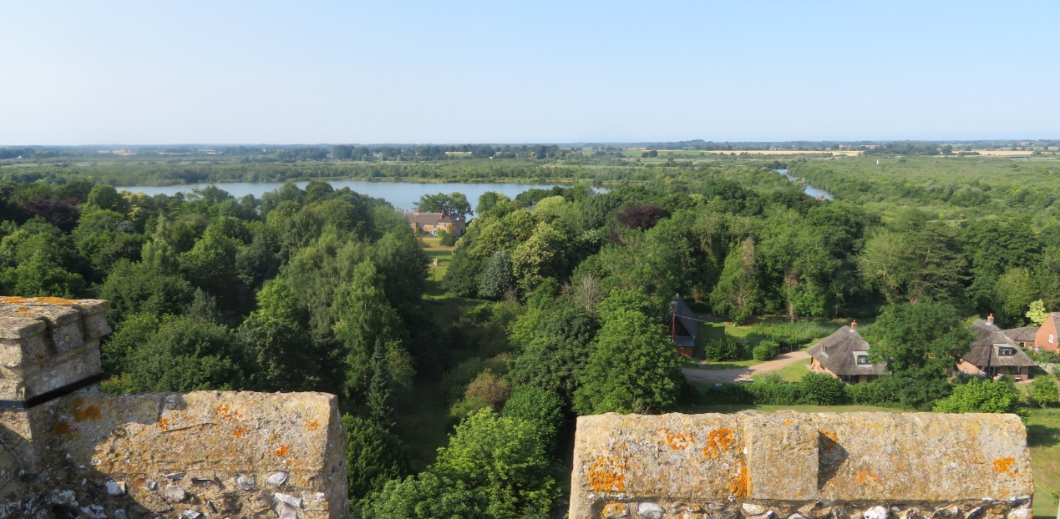
England
© Abielle Hallas
Sonnenuntergang über den Liverpooler Docks
Bedruthan-Steps in Cornwall
© Elizabeth Burroughs
Ranworth Kirche, Norfolk
© 2020 Nick Hallas
Notes:
England has less dramatic landscapes but includes a spectacular coastline, especially in the West Country, while the north has lakes, mountains and large areas of moorland and forest. England has the highest level of urban development.

Slide 6
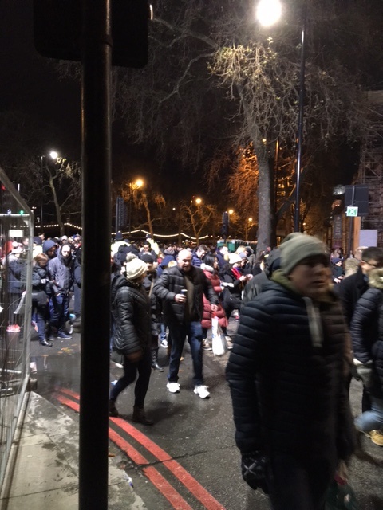
Menschen, Vielfalt und Migration
© Carole Bourne
Notes:
We have a population of approximately 70 million people. Belfast, the capital of Northern Ireland, and Cardiff, the capital of Wales, each has a population of more than half a million.
In recent times, London has attracted a huge, diverse population of about nine million to work in its financial and service sectors.

Slide 7
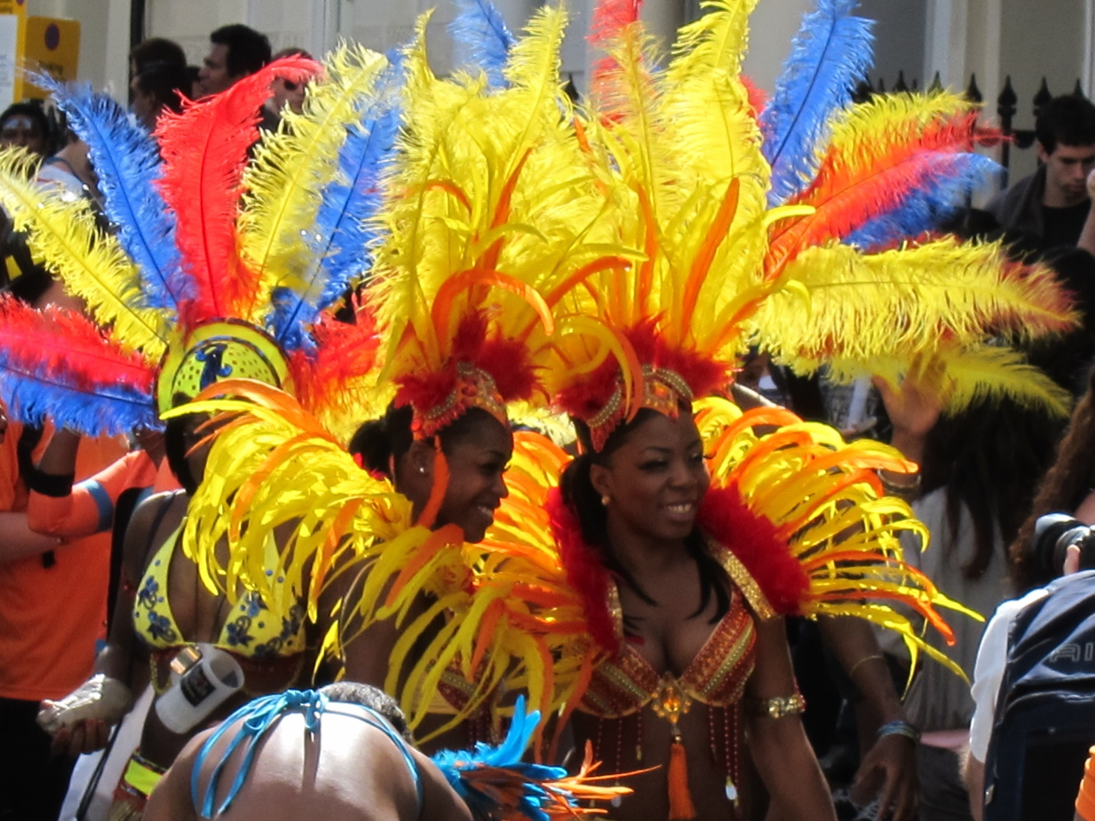
© Ana Gobledale
Notes:
The population of England, Wales and Northern Ireland has been enriched over the centuries by waves of migration.
Immediately after the Second World War, there was a wave of immigration mainly from the Republic of Ireland and Jamaica. This was followed by a larger wave, mostly from other Commonwealth countries, especially Pakistan and India. However, in the 21st century, more immigrants have come from Europe.

Slide 8
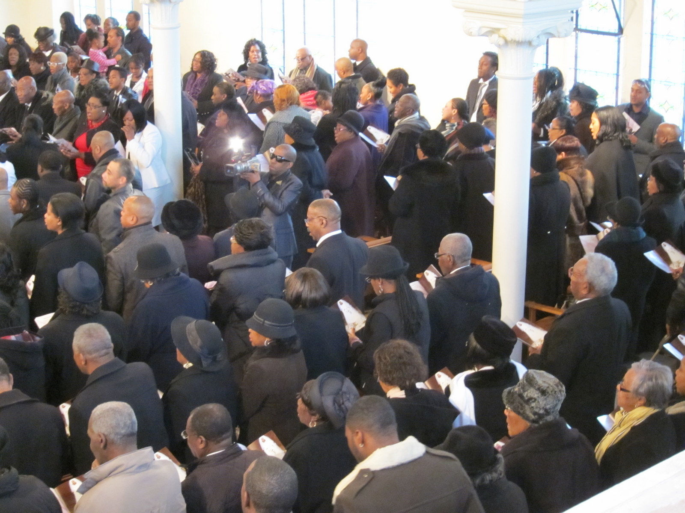
© Ana Gobledale
Notes:
Diversity is now a way of life in our towns and cities. Whilst there are some wary of immigration, most of us who are second and third generation immigrants feel ourselves to be well-integrated and sometimes struggle when asked, 'Where do you come from?'

Slide 9
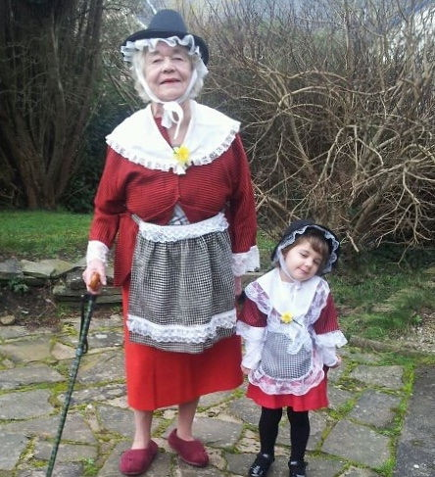
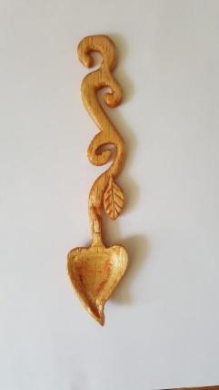
Traditionelle walisische Tracht
und walisischer Liebeslöffel
© Sarah East
© Jay Griffiths
Notes:
The relationship between the peoples of England, Wales and Northern Ireland has not always been straightforward or peaceful. In the 13th century, Wales experienced oppression and conquest at the hands of King Edward I of England.
The Welsh translation of the Bible by William Morgan (1588) and its use in non-conformist churches throughout the 19th and 20th centuries played a significant part in perpetuating the language through difficult times. After years of campaigning, Welch was finally made an official language in 2011.
Since 2007, Wales has had its own government with certain functions devolved to the capital Cardiff from the Westminster Parliament.

Slide 10
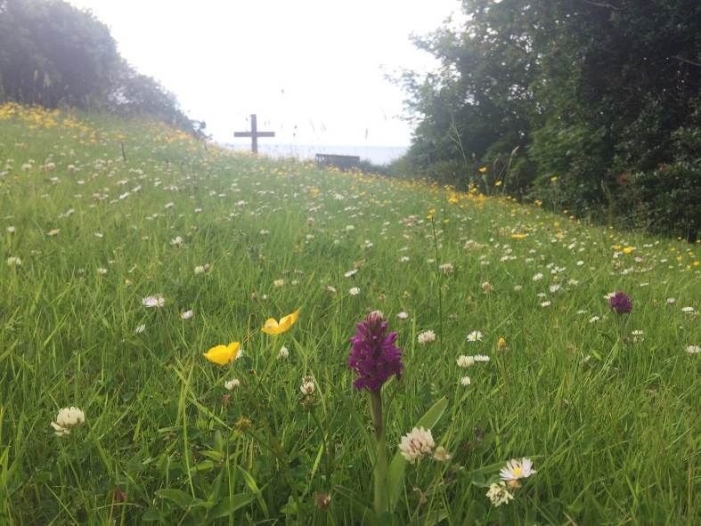
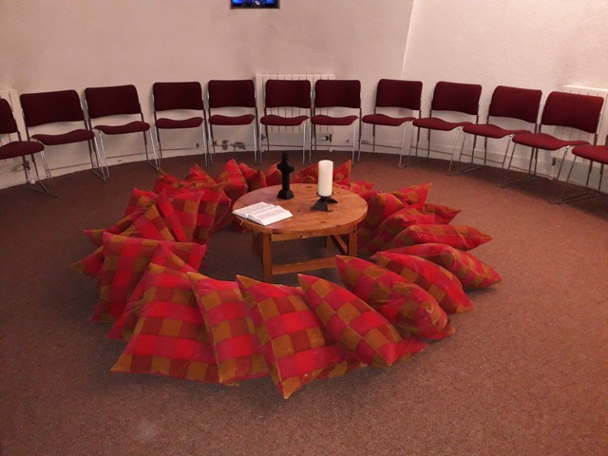
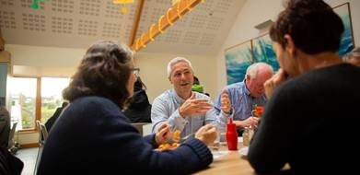
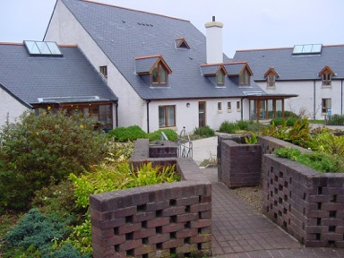
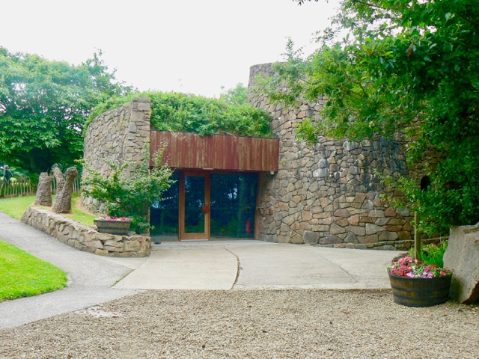
Die Corrymeela Community
Nordirlands älteste Friedens- und Versöhnungs-organisation
All © The Corrymeela Community
Notes:
Northern Ireland was formed in 1920 after the Unionist majority in the province decided they wished to remain in the United Kingdom and not join a United Ireland. This led to periods of civil unrest when, in 1968, violence erupted.
Influential in seeking ways to end the violence were Nobel prize-winners Mairead Corrigan Maguire and Betty Williams who founded the Community of Peace People. In 1998, the signing of the Good Friday Agreement signalled the end of most of the violence of The Troubles and, as a result, a power sharing Assembly was established.

Slide 11
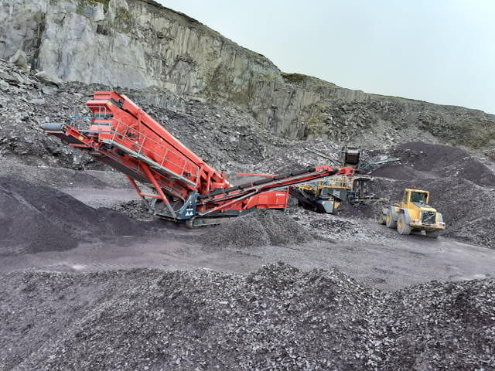
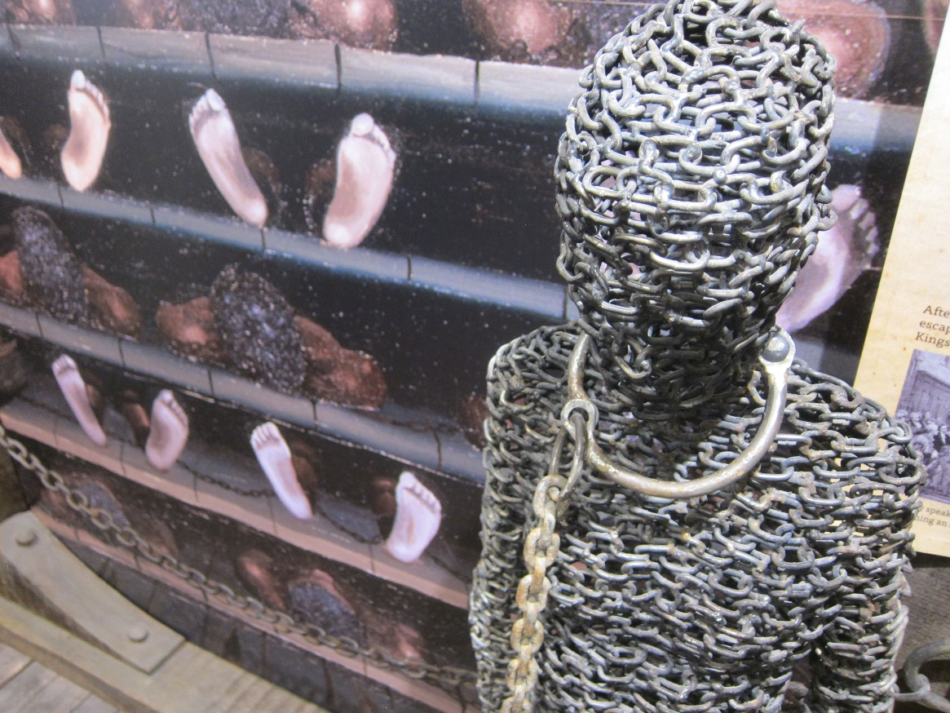
Unseren Platz in der Welt finden
© Mary Thomas
© Ana Gobledale
Notes:
Growing through seafaring, exploration, piracy, trade and colonisation, we were among the first in the world to industrialise, exploiting our own geological resources of coal, slate and tin and, later, those of the countries we colonised. We are increasingly aware of the role of the Empire in the slave trade that spanned the world and the effects of climate change resulting from these technological advances.

Slide 12
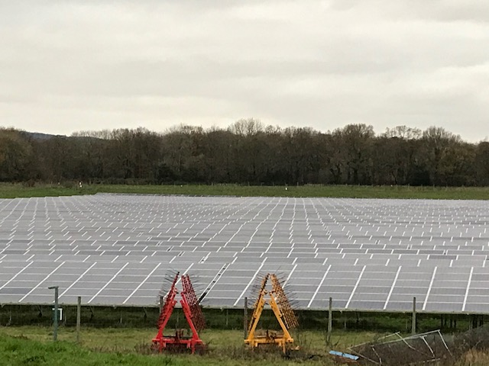
Sonnenkollektoren
© Carole Bourne
Notes:
In a world where natural resources are scarce and the planet is warming, what is our role? Britain currently has climate targets, and has set 5 yearly carbon budgets until 2032 to try and meet these targets. The first carbon budget (2008-12) has been met and the UK is currently on track to outperform the second (2013-17) and third (2018-22) carbon budgets, but is not on track to meet the fourth, which covers the period 2023-27.
As a country that industrialised early, there is an argument for limiting our emissions to a greater extent by using alternative sources of energy: solar and wave power, and wind farms. There have been weeks when no coal has been burned.

Slide 13
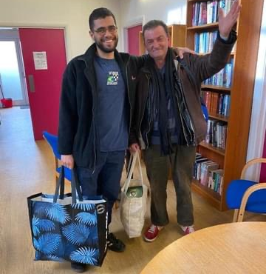
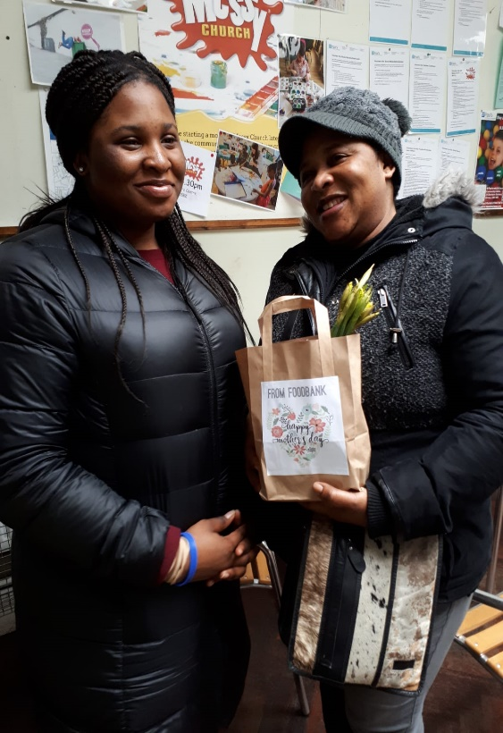
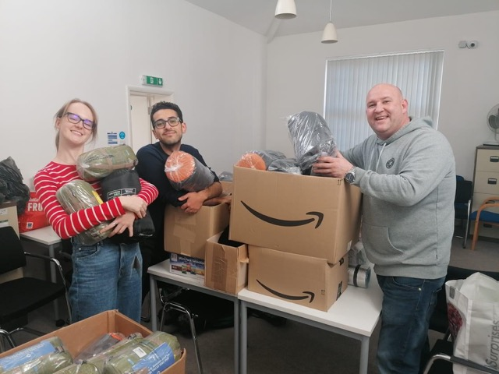
Lebensmitteltafel: Churches Together in Brixton
© KCAH
© Audrey Eccleston
© KCAH
Kingston Churches Action on Homelessness' (Aktion der Kirchen gegen Obdachlosigkeit)
Wohnungsberatungsdienst
© Audrey Eccleston
Notes:
A 2018 United Nations report described the levels of poverty in Britain as unacceptable, with 14 million people in the UK found to be living below the poverty line.

Slide 14
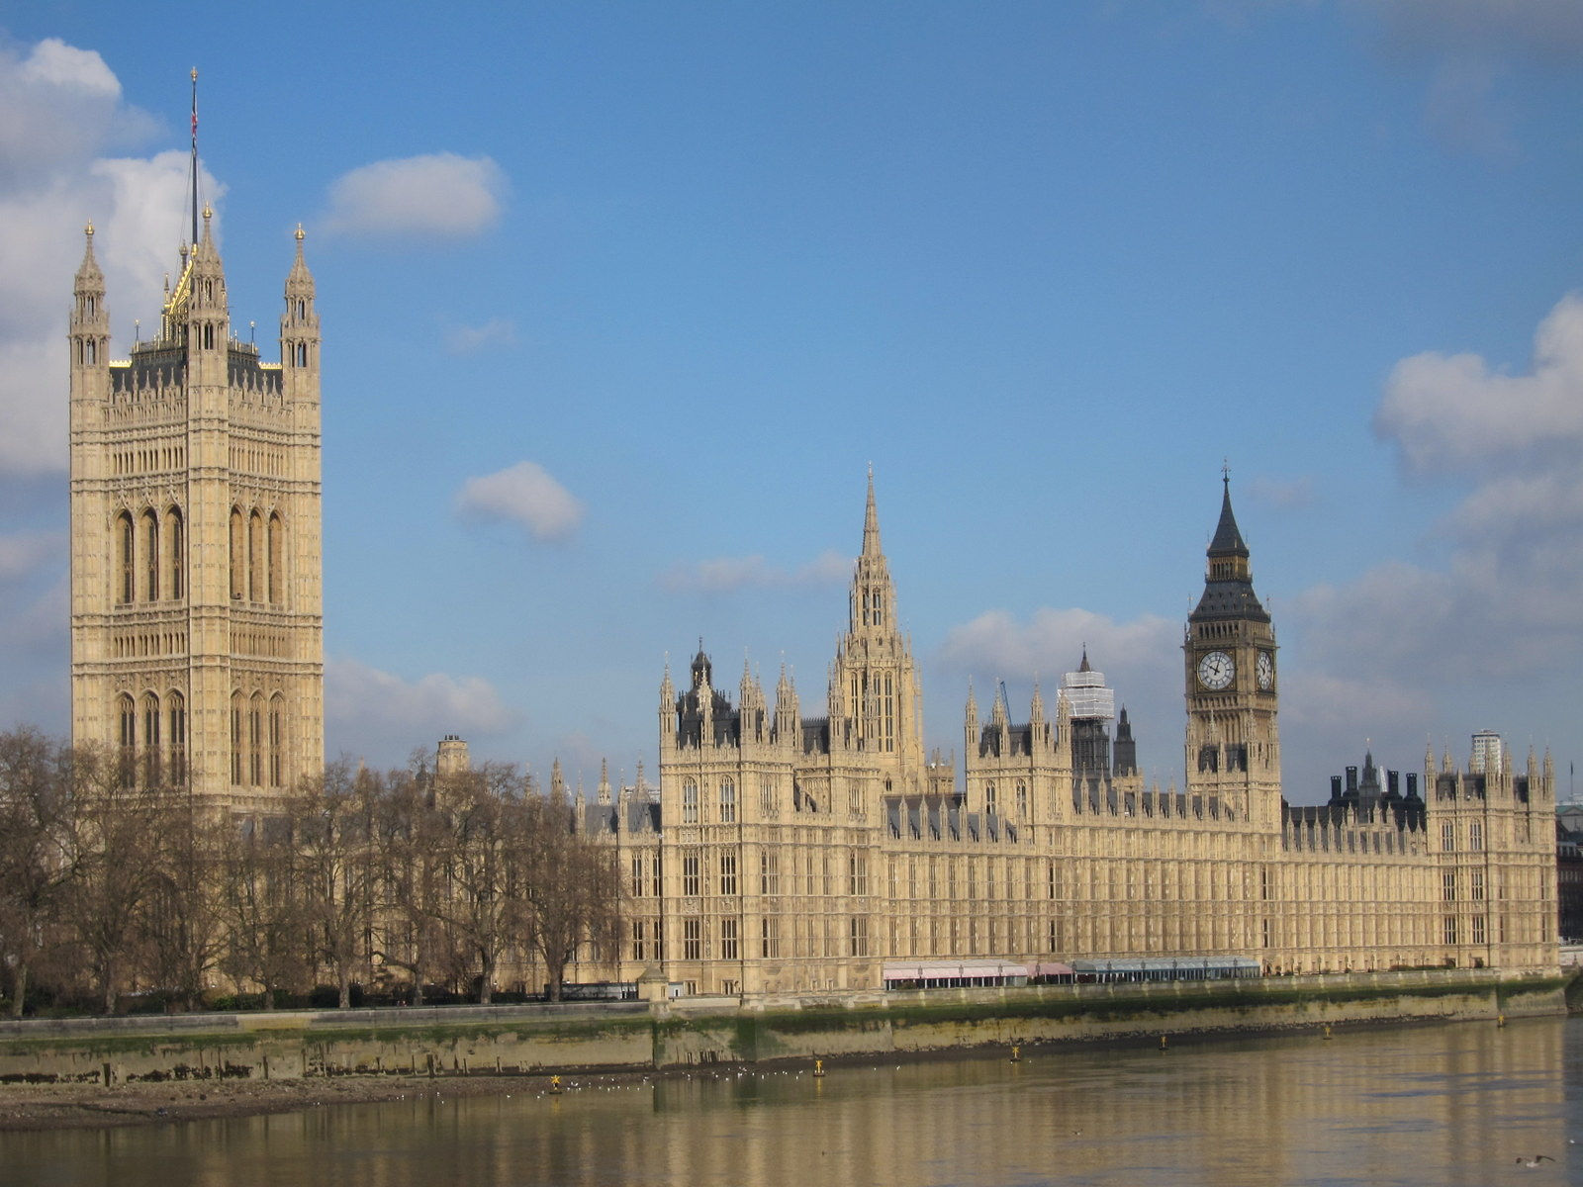
Houses of Parliament, London
© Ana Gobledale
Notes:
In 2016 England, Wales, Scotland and Northern Ireland voted collectively for ‘Brexit’, to leave the European Union, In England and Wales, the vote to leave won by 52%; Scotland and Northern Ireland voted to remain in the European Union. The Brexit plan was approved in 2019, and the government is in charge of its implementation.

Slide 15
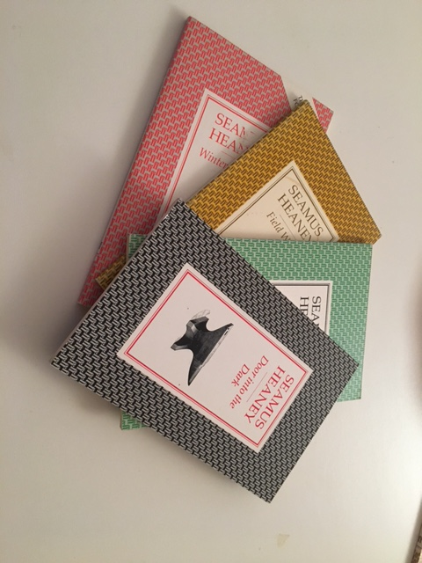
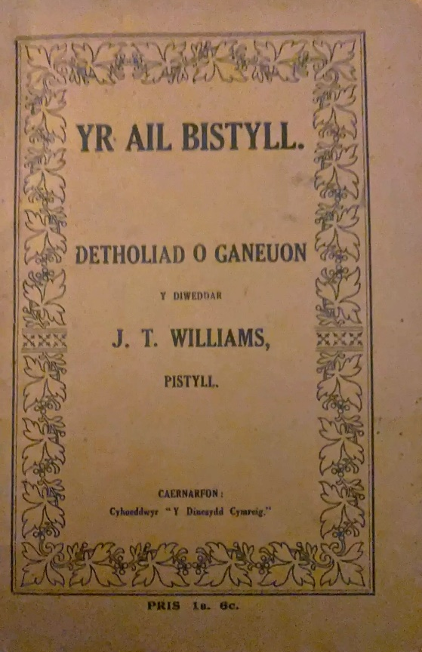
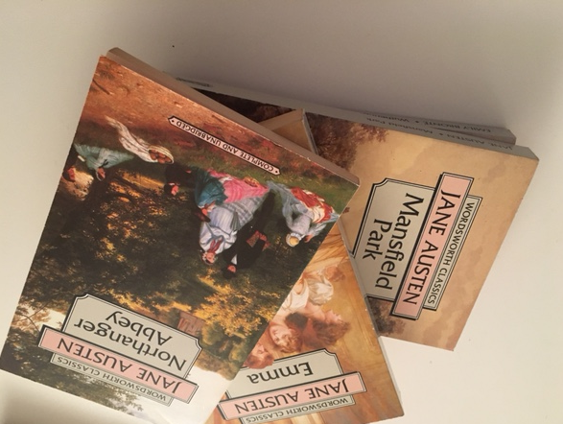
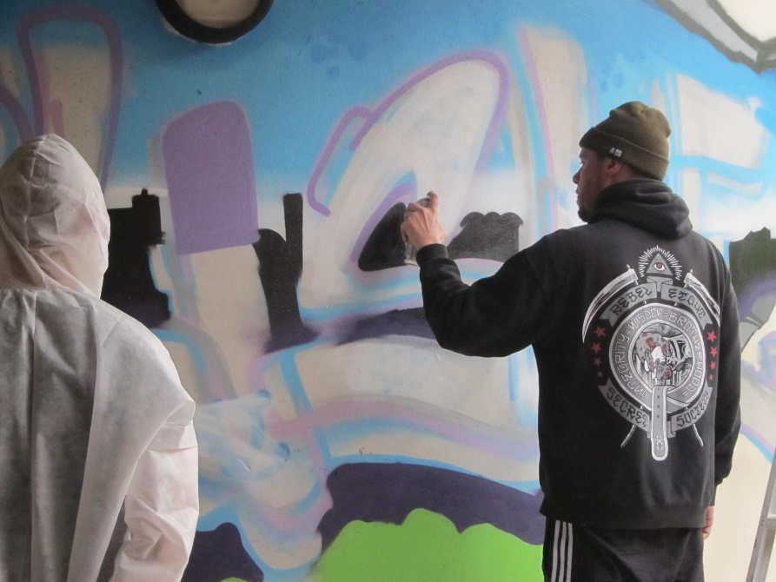
Kunst & Kultur
© Carole Bourne
© Carole Bourne
© Robert Jones
© Ana Gobledale
Notes:
England, Wales and Northern Ireland have been influenced and shaped by an array of extraordinary talents, through science, music, theatre, poetry, literature, dance, festivals and other forms of art.
Shakespeare, Jane Austen, Zadie Smith, Seamus Heaney, and Dylan Thomas are just a few of the writers whose works are read and studied across the globe.

Slide 16
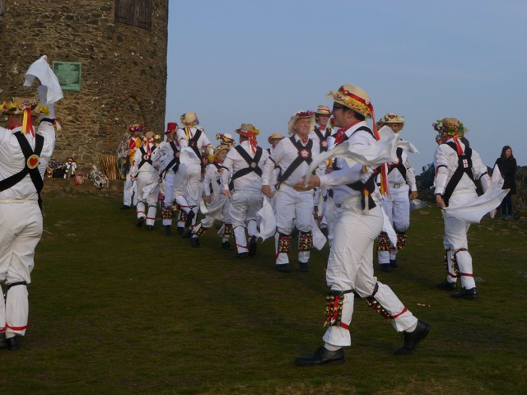
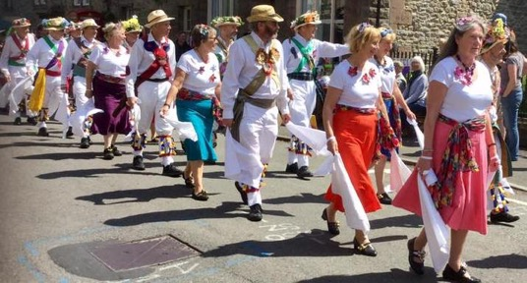
© M Pickford
Morris-Tanz
© N M Hoskin-Stone
Notes:
Music is a vital part of our culture, and across the nations it is expressed in different forms: through classical music, ballads, punk, rock, pop, grime, folk, Morris dancing and Welsh male voice choirs, alongside traditional Celtic folk music.

Slide 17
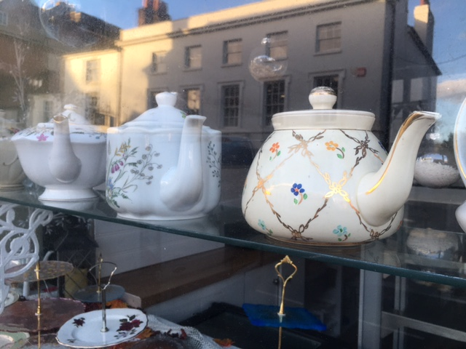
Essen & Trinken
© Carole Bourne
Notes:
The slightly damp climate in England, Wales and Northern Ireland means that traditional food is often comforting and warming. Stew and dumplings, hot pies and sweet puddings have been enjoyed for hundreds of years. A nice cup of English Breakfast or Earl Grey tea is a typical hot drink, but coffee is also extremely popular.

Slide 18
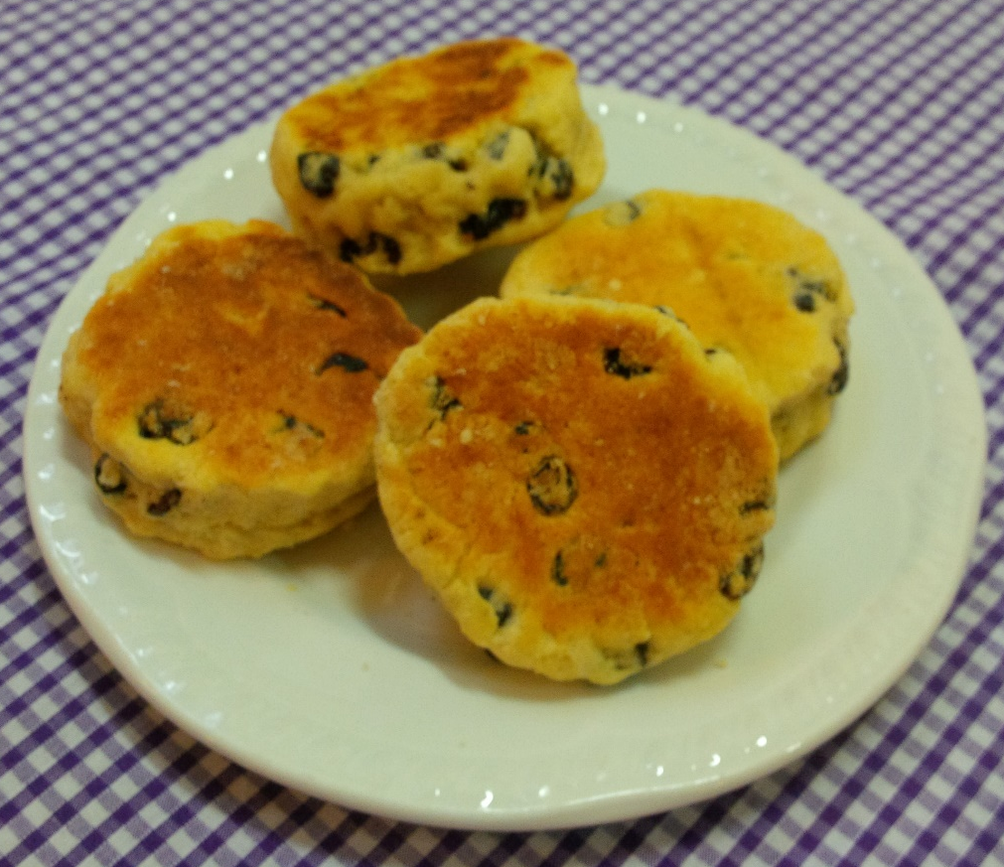
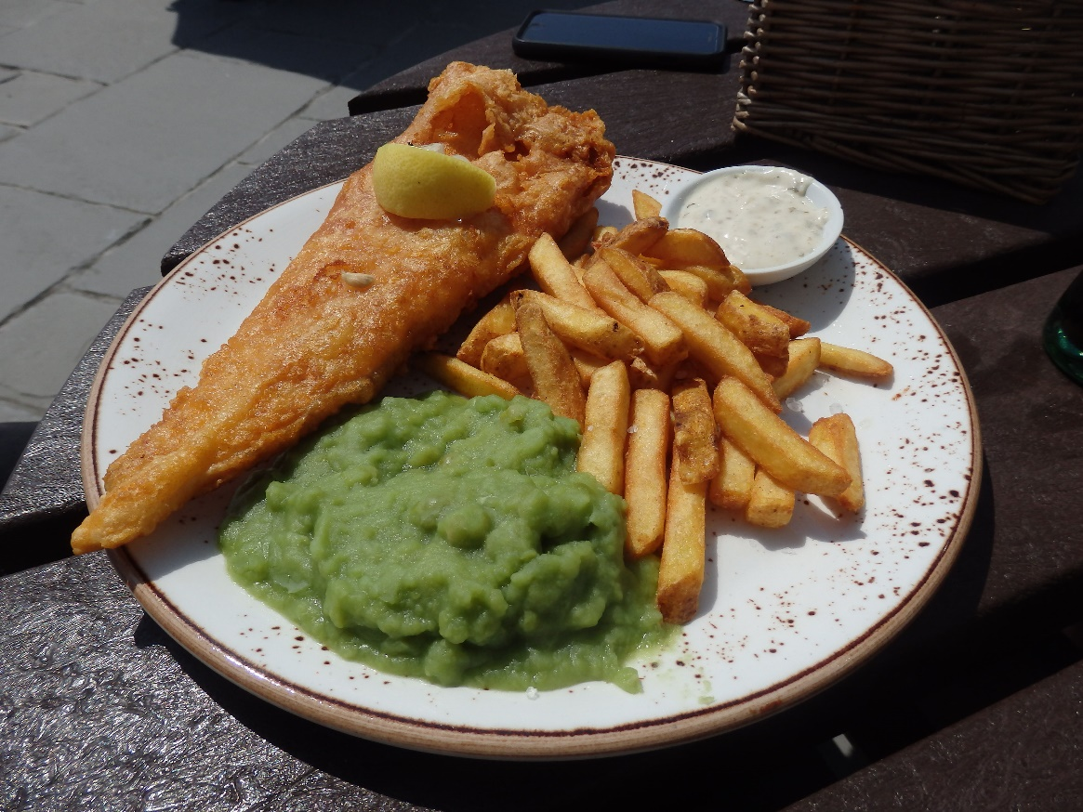
Welsh cakes, Waliser Kuchen
© Christine Miles
Fisch und Chips mit pürierten Erbsen
© Elizabeth Burroughs
Notes:
Meals that are seen as a core part of the nation’s identity – such as fish and chips - have often been introduced by refugees and settlers from other countries.
There are national dishes and special regional variations in each country, for example Welsh cakes and Northern Ireland champ. England can claim many local delicacies and foods which are now exported all around the world.

Slide 19
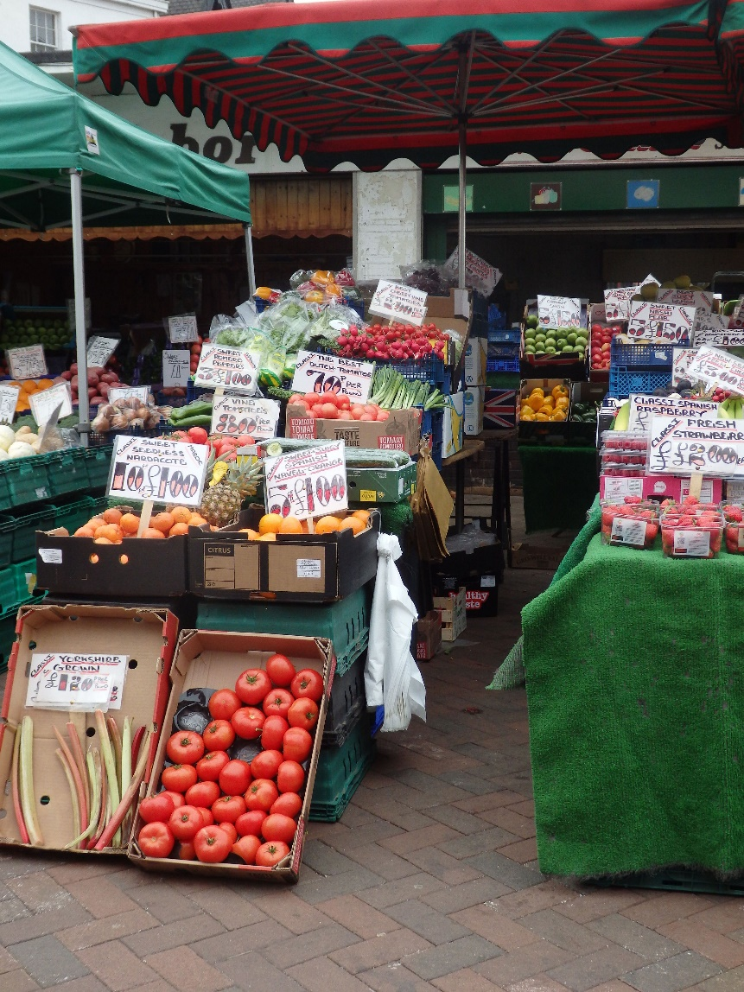
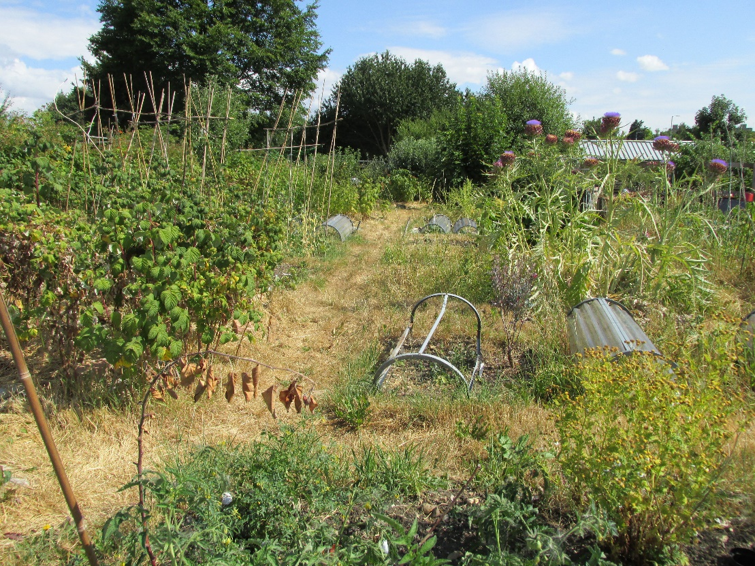
© Stephanie Grant
© Elizabeth Burroughs
Notes:
Many people attempt to eat healthily in England, Wales and Northern Ireland but, as in many countries, it is easier to access convenience food and ‘junk’ food which is high in carbohydrates and sugar.
And yet there is hope. Allotments (council-allotted pieces of land on which to grow fruit, vegetables and flowers) and community gardens are becoming very popular once more

Slide 20
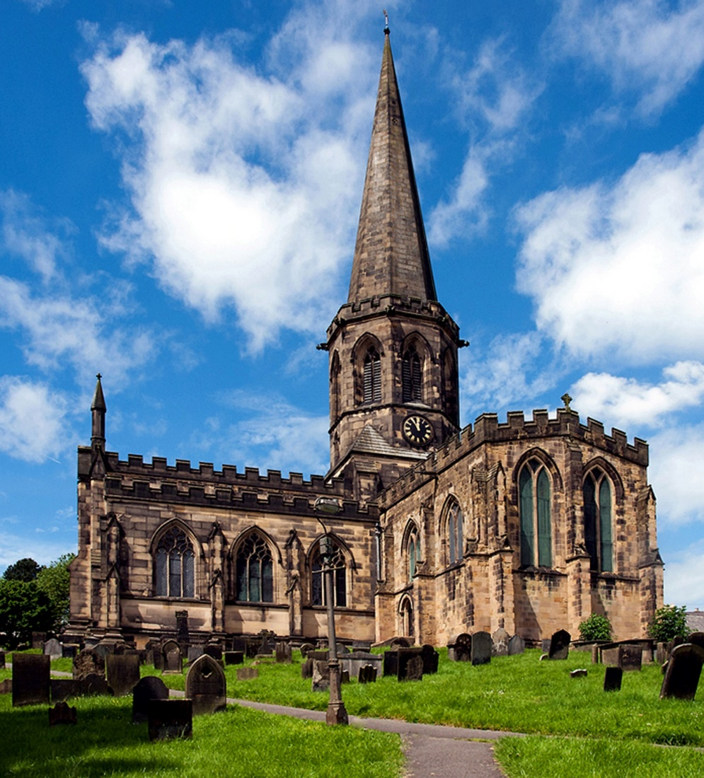
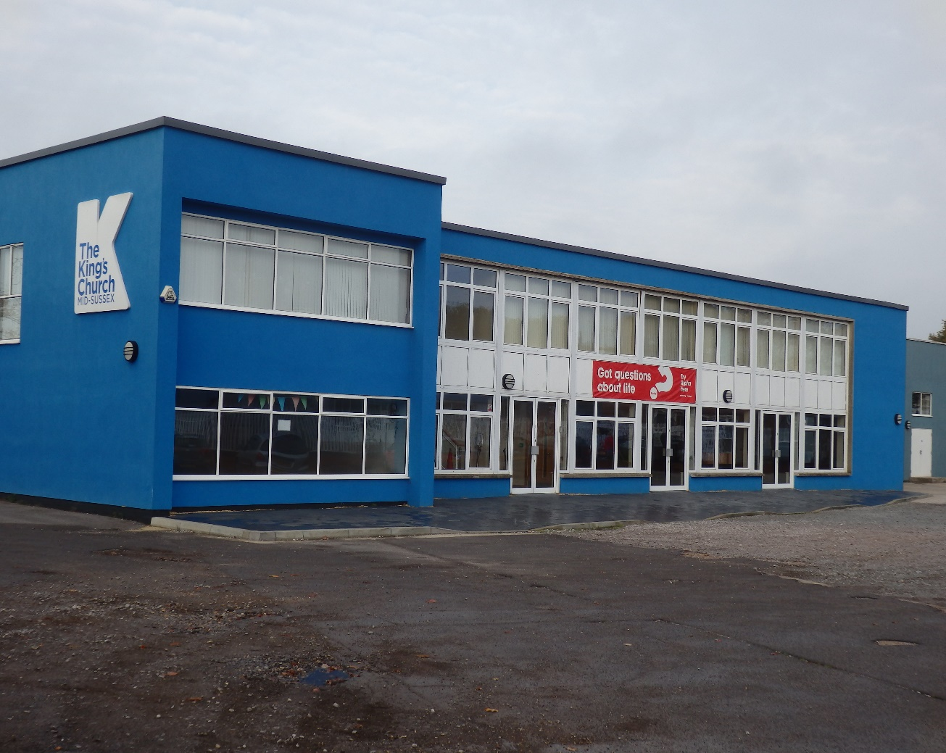
Religion
© Elizabeth Burroughs
The King’s Church, Burgess Hill, West Sussex
© Brian Walbey
All Saints-Pfarrkirche, Bakewell, Derbyshire
Notes:
We are steeped in history. Many of our cities have beautiful ancient buildings, dating back to medieval times, including cathedrals and churches built by our Christian ancestors. Today our modern churches may seem much less beautiful but are often more practical.

Slide 21
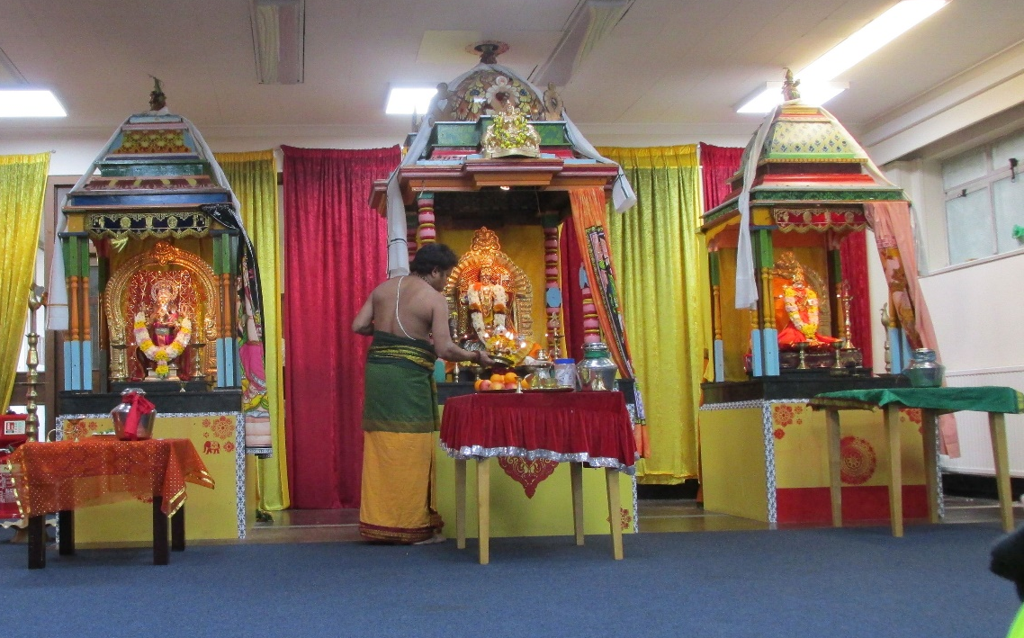
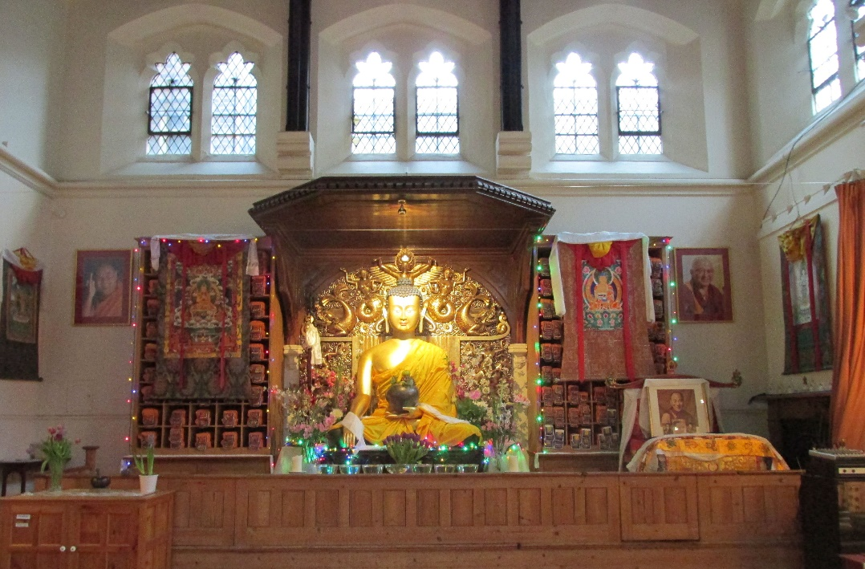
© Stephanie Grant
© Stephanie Grant
Hindu-Tempel in einem Bürogebäude in Watford
Buddhistischer Tempel in einem hohen Gerichtsgebäude in Elephant and Castle
Notes:
We have rich cultures in multi-ethnic communities such as Birmingham, Leicester, and, in London, the East End and Southall. Bevis Marks synagogue in the East End dates back to 1701; Woking, in Surrey, is the home of England’s first mosque, built in 1889 by a Hungarian immigrant; Neasden’s Hindu Temple occupies a huge site in North West London. There is a building in London’s Brick Lane that has been a Methodist chapel, a Huguenot church and a synagogue, and is now a mosque.

Slide 22
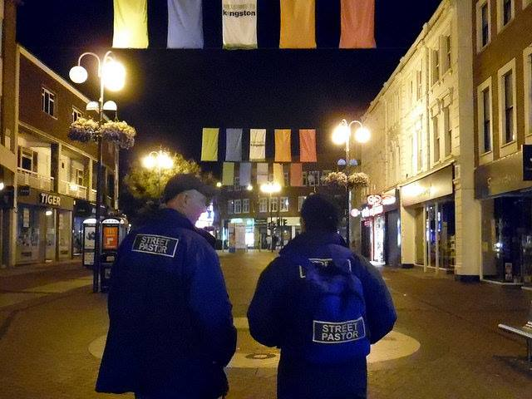
© Oxygen (Kingston Street Pastors)
Notes:
There have also been huge shifts in terms of religious observance. Like much of Western Europe, the general picture in terms of church attendance in England, Wales and Northern Ireland is one of decline, particularly in the mainstream denominations. Yet despite this, the church is often at the forefront of projects to help those in need, such as food banks, homeless shelters and work among refugees. The church, too, has been reinvigorated by recent immigration.
Street pastors is an interdenominational church response to issues on our streets, started in Brixton by Les Isaac in 2003, inspired by an organisation he had seen in Jamaica, where individual churches joined together to take their presence and values on to the streets. It provides practical help to those engaging with the pubs and clubs of the night-time economy, and gives direction and advice to the homeless. Currently there are 270 Street Pastors groups nationally, seven internationally and the organisation has worked with over 12,000 volunteers.

Slide 23
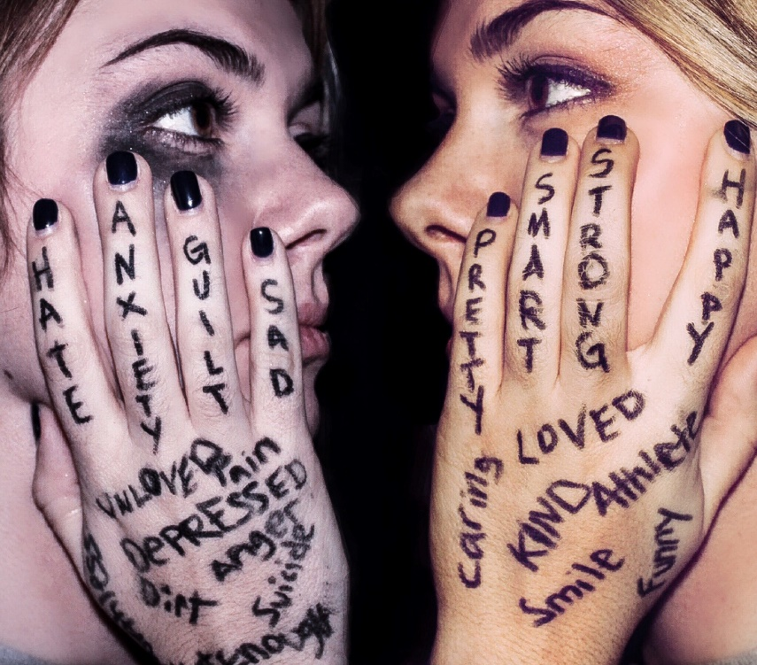
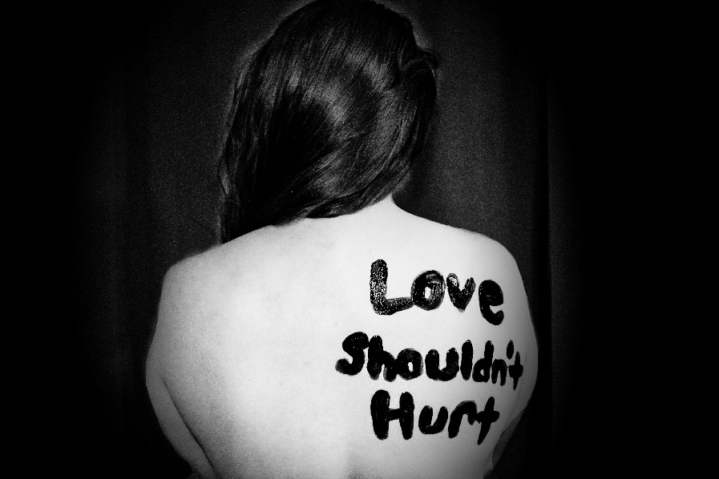
Frauen
© Sydney Sims
© Sydney Sims
Notes:
Even though, we celebrated the progress women have made in our society, we still struggle to combat violence in our homes, improve the lives of those living in poverty and support those with disabilities, physical, mental and emotional.

Slide 24
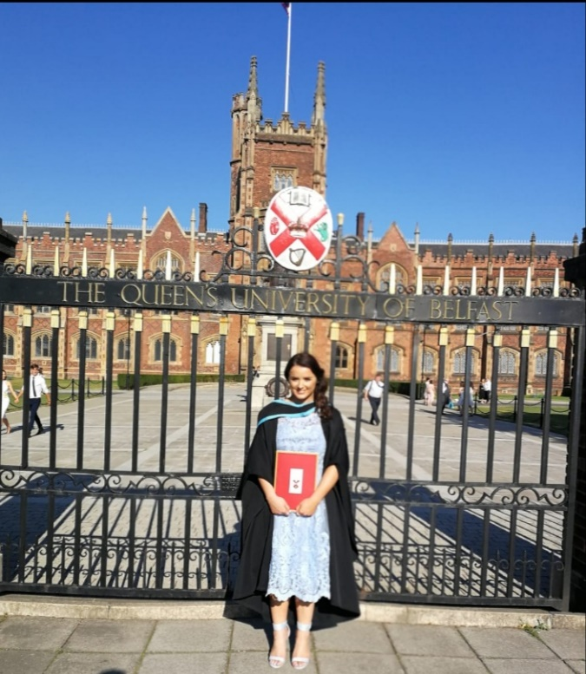
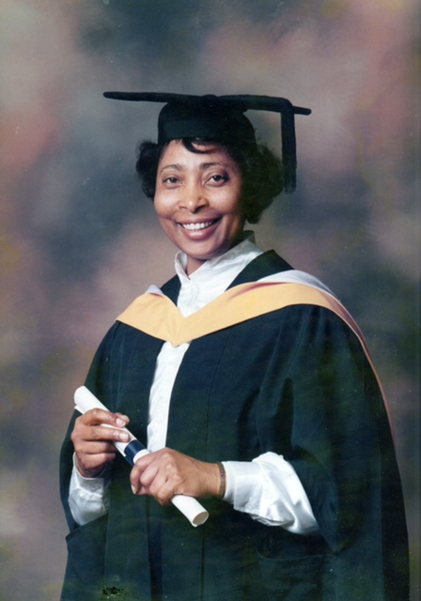
© Melissa Hughes
© Audrey Eccleston
Notes:
Although Oxford and Cambridge Universities did not allow women to graduate until 1920, women now make up more than half of those studying for first degrees. They are still in the minority only in science, technology, engineering and maths.

Slide 25
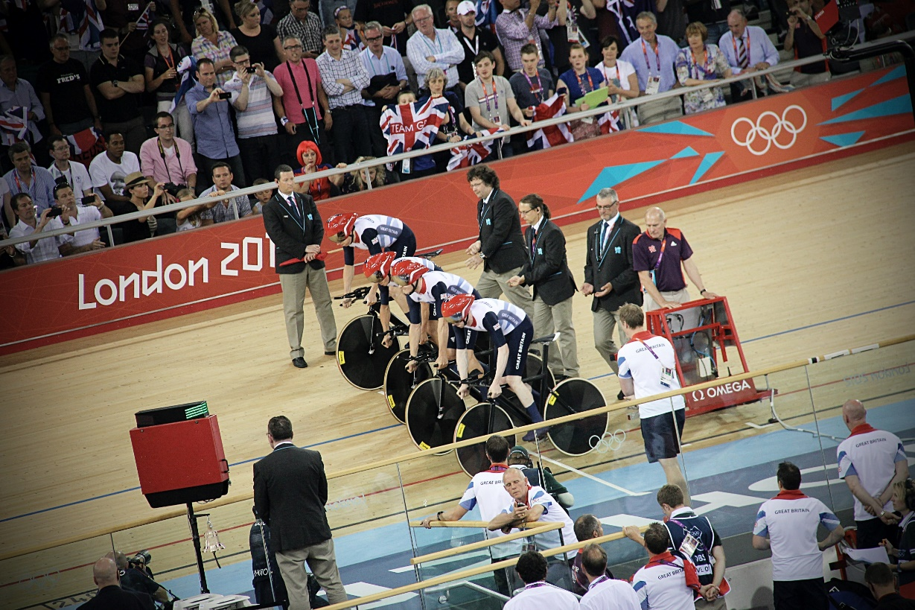
© Simon Connellan
Notes:
Female participation in popular sports is gaining more respect and interest, resulting in better coverage on TV and the rest of the media. Women's football has seen a huge rise in popularity and the English women's cricket team members are past winners of the Women's Cricket World Cup.

Slide 26
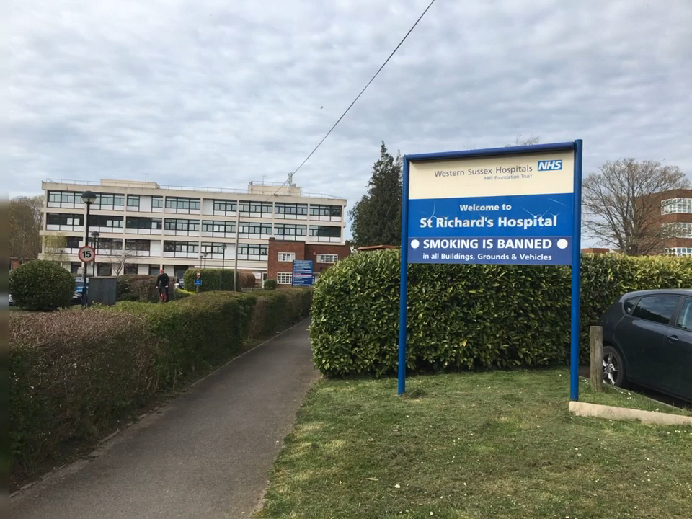

Gesundheit
© Carole Bourne
© Justin Dickens
Notes:
In March of 2020, the World Health Organization declared that a viral disease named as COVID-19 had swept into at least 114 countries and killed more than 4,000 people. It was then declared a pandemic caused by a coronavirus. The outbreak reached the UK, and as most people the world over, the inhabitants of the UK lived in social isolation to slow the transmission of COVID-19.

Slide 27




Geschichte des WGT
All © Elizabeth Burroughs
Notes:
As a single World Day of Prayer organisation, the three voices of England, Wales and Northern Ireland, have come together to present this years’ service, recognising our differences but also our common ground.

Slide 28

Grace Forgan
© WDP EWNI
Notes:
In 1928, at the International Missionary Conference in Jerusalem, Scotswoman Grace Forgan first learned of the World Day of Prayer and brought the news to the United Kingdom. The first service was held in 1930 in Scotland; followed by England in 1932, Wales in 1933 and Northern Ireland in 1943.

Slide 29



© WDP EWNI
Together in Prayer Magazine
Karte der Feiern 2020
© 2020 GeoBasis-DE BKG
Liturgien
© WDP EWNI
Notes:
During the period of the Second World War, women felt the urge to get together in prayer and fellowship. In 1967, after Vatican II, Catholic women began to take part in our service. In England, Wales and Northern Ireland there are now about 3,000 branches holding more than 4,000 services every year. In 2019, 275,000 copies of the order of service were printed.

Slide 30


Heute
© WDP EWNI
Notes:
Currently, WDP National Committee includes 18 different Christian denominations. We allocate over 40 grants to national and international charities.

Slide 31

© WDP EWNI
Notes:
Our office in Tunbridge Wells co-ordinates the distribution of service materials, including activities for children and youth and our website carries news of all we do. We also post on Twitter and Facebook.

Slide 32

Y-Pray?
© Elizabeth Burroughs
Notes:
In response to what we saw as a need to involve younger participants, our WDP now organizes an annual Y Pray? event in May, when younger women are encouraged to join us for a weekend of prayer, fellowship and entertainment.

Slide 33

© Elizabeth Burroughs
Y-Pray? 2019
Notes:
Young people across England, Wales and Northern Ireland are hope-bringers and culture transformers. God is using them to shine light in hopeless places. What’s your #WDPhope?

Slide 34


Die Liturgiegruppe
© Elizabeth Burroughs
© WDPIC
Notes:
The writing process of the worship service materials started on November 2018, with the workshop led by WDPIC. Then the working groups were formed and started the collaborative writing of the materials coordinated by EWNI WDP Committee.

Slide 35


Die Künstlerin und das Titelbild
© WDP EWNI
Notes:
Growing up in Norfolk, Angie Fox learned to knit and sew from her mother but has continued learning new needlework and other craft skills throughout her life.
“I am thrilled to be chosen to represent, in art, the prayers of the women of my country. I have so many memories of organising and participating in WDP services at home and abroad and I love the feeling of togetherness, knowing that, all over the world, the same prayers are being offered in many languages, and cultures, churches and meeting places.”

Slide 36
Angie Fox
© WDP EWNI
Notes:
Following the theme given, she used several images to depict the key words as follows:
Freedom: an open door to a pathway across an endless open vista;
Justice: broken chains;
God’s Peace and Forgiveness: the dove of peace and a peace lily breaking through the pavement;
Over all, a rainbow which has come to represent all these things from the story of Noah through to the modern day. It is a symbol of the overreaching love of God.

